Slide 1
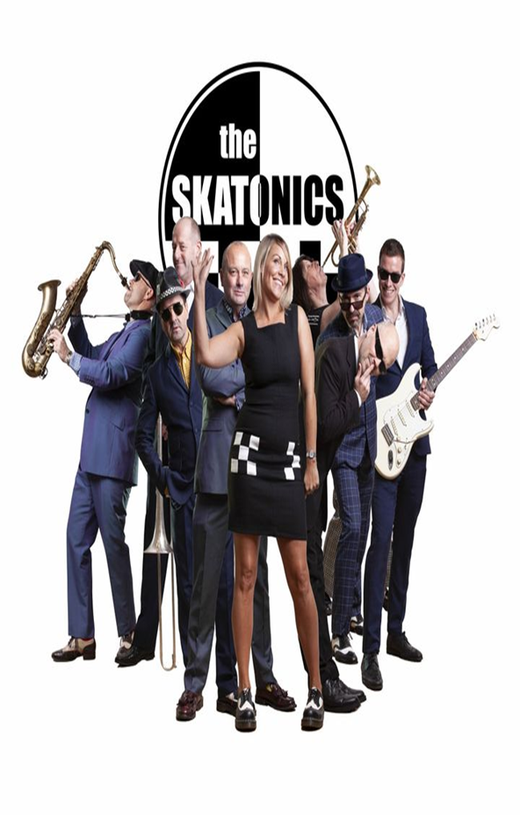
Saturday
26th February

